Slide 1
Agenda
Introduction
Cloud – the big picture
Opportunities
Virtual Machines vs Containers vs Serverless
Serverless definition
Why Serverless?
Strategy to move to Serverless (Demo)
Recap

Slide 2
Introduction
Telecom Industry experience
How do I know Dr. Sridhar Alagar
Studied undergraduate CS program at the same time
Worked alongside in Grenoble France
Sridhar on the OS team
I worked on the Networking team
Built and managed many teams
Retrained employees
Conducted hackathons
Cloud certifications for employees
Technology enthusiast

Slide 3
Cloud – Big picture
Cloud is Empowering
Mobile phone increase productivity
+10% mobile penetration => 0.6 increase in GDP(causal)
Broadband even more so
+10% broadband penetration in India => 1.4% increase in GDP
But only after 25% threshold is reached
Claim: Access to the Cloud will be better still
(tailored) education and self-education
Medicine, agriculture and remote expertise in general
Hope and social mobility
UTD Graduate students perspective
Access to infrastructure at unprecedented scale
New opportunities
Building the future cloud (Amazon, Microsoft, Google)
Tools and Frameworks for the cloud
Building innovative new (metered) services
How to differentiate yourself?
Polyglot programmer
GitHub presence
Cloud certifications

Slide 4
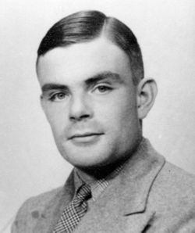
Alan Turing’s Perdiction #1
In 1945 Alan Turing writes “We shall need a great number of mathematicians of ability” because “there will probably a good deal of work of this kind to be done.”

Slide 5
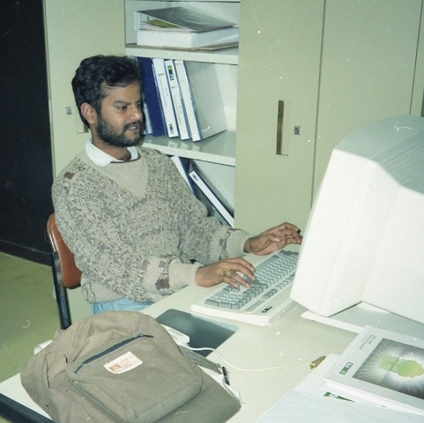
History of compute
Cray 2, 1985 | iPhone 4, 2010 | Apple Watch, 2015 | ~2B FLOPS
CM-5, 1991 | 2x Samsung S6 | 1 Haswell Core | ~100B FLOPS
IBM ASCI RED, 2000 | Playstation 4, 2013 | 32-core Haswell | ~3,000 FLOPS
State of the art CRT Monitors that weighed 100 pounds
Google Photos – Search by People (Face recognition cloud service)
Demonstrates the power of the cloud
Source: http://pages.experts-exchange.com/processing-power-compared

Slide 6
Power of cloud
The power of cloud has enabled extraordinary growth in the areas of Artificial Intelligence and Machine learning
Two real world examples
AlphaZero – ML – Power of the cloud
Google Duplex: An AI System

Slide 7
AlphaZero – ML – Power of the cloud
One Giant Step for a Chess-Playing Machine
The stunning success of AlphaZero, a deep-learning algorithm, heralds a new age of insight — one that, for humans, may not last long.
Dec. 5, 2017, the team had stunned the chess world with its announcement of AlphaZero, a machine-learning algorithm that had mastered not only chess but shogi, or Japanese chess, and Go. The algorithm started with no knowledge of the games beyond their basic rules. It then played against itself millions of times and learned from its mistakes. In a matter of hours, the algorithm became the best player, human or computer, the world has ever seen.
Source: https://www.nytimes.com/2018/12/26/science/chess-artificial-intelligence.html

Slide 8
Alan Turing’s Perdiction #2
“It seems probable that once the machine thinking method had started, it would not take long to outstrip our feeble powers… They would be able to converse with each other to sharpen their wits”

Slide 9
Google Duplex: An AI System
for Accomplishing Real-World Tasks Over the Phone
enable people to have a natural conversation with computers, as they would with each other. In recent years, we have witnessed a revolution in the ability of computers to understand and to generate natural speech, especially with the application of deep neural networks
a new technology for conducting natural conversations to carry out “real world” tasks over the phone. The technology is directed towards completing specific tasks, such as scheduling certain types of appointments.
One of the key research insights was to constrain Duplex to closed domains, which are narrow enough to explore extensively. Duplex can only carry out natural conversations after being deeply trained in such domains.
cannot carry out general conversations
Passes Turing Test (at least in my mind)

Slide 10
Alan Turing’s Perdiction #3
“I believe that at the end of the century the use of words and general educated opinion will have altered so much that one will be able to speak of machines thinking without expecting to be contradicted”

Slide 11
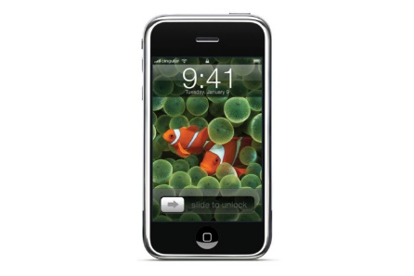

Back to the future of cloud compute
Decade of the Mobile and Cloud
decade of smartphone - iPhone launch 3rd qtr 2007
decade of cloud computing – AWS EC2 3rd qtr 2006
Cloud tools and technology rapidly evolving
In some ways, its turning the clock back
Back to the future of cloud compute
1995-2000 - No virtual machines, focus on scalable services on top of storage/DBs
Current Cloud: sea of virtual machines/containers managed by Kubernetes
Transition Technology: VMs enabled Enterprise to move from on-prem into the cloud
Kubernetes is old wine in a new bottle
Future Cloud: return to sea of persistent services
VMs/Containers are gone or invisible
VMs/Containers will be orchestrated by Kubernetes will operate in the background
The step in that direction is Serverless - Today’s topic
Source: http://pages.experts-exchange.com/processing-power-compared

Slide 12
Serverless is a misnomer
Serverless is a misnomer – There is a server Afterall!
How to You define serverless?
The Cloud Native Computing Foundation (CNCF) defines serverless as: “where applications, bundled as one or more functions, are uploaded to a platform and then executed, scaled, and billed in response to the exact demand needed at the moment.”
Gartner, by contrast, defines serverless as: “Serverless computing is a model of IT service delivery in which the underlying enabling resources are used as an opaque, virtually unlimited, shared pool that is continuously available without advance provisioning (preprovisioning) and priced in the units of the consumed IT service”.
‘Serverless’ refers to a new generation of platform-as-a-service offerings where the infrastructure provider takes responsibility for receiving client requests and responding to them, capacity planning, task scheduling, and operational monitoring. Developers need to worry only about the logic for processing client requests.

Slide 13
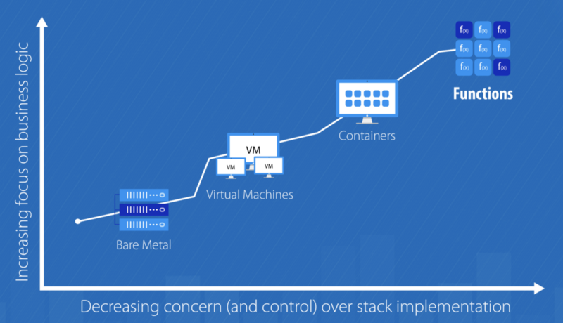
Baremetal Vs Virtual Machines vs Containers vs Serverless

Slide 14
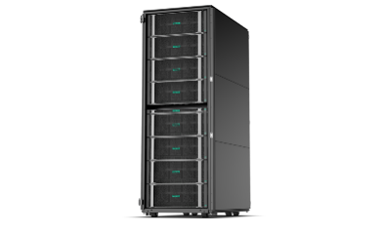
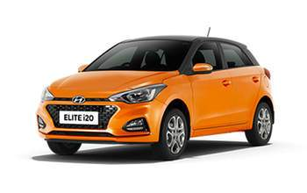
Total cost of ownership
Real world Enterprise Customer and Network Ticketing Application

Slide 15
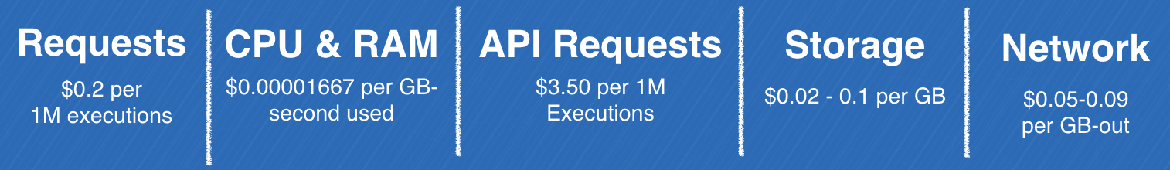
Serverless calculator

Slide 16
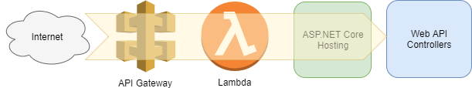
How to transition to Serverless
Problem: Costly to re-write entire applications
Solution :
Modernize you backend to be RESTful
lambdas triggered by API Gateway and let your code handle the routing
Demo time (finally!) - Set up a .net Core “Todo” Web API on lambda with the serverless framework.
Prerequisites
AWS account
Node.js and npm installed
.net Core SDK 2.1 installed
Serverless Framework installed
$ git clone https://github.com/rock-meister/ServerlessTodoApi.git

Slide 17
AWSLambda shortcomings
High-Throughput Data Processing Pipelines or APIs
APIs with Predictable Spikes in Traffic
Real-Time Applications
Serving Machine Learning Models in Real Time
Long-Running Jobs and Services
No Specialized Hardware
Limited Lifetimes

Slide 18
Recap
Cloud
Rapidly evolving
New opportunities
Building the future cloud (Amazon, Microsoft, Google)
Tools and Frameworks for the cloud
Building innovative new (metered) services
How to differentiate yourself?
Polyglot programmer
GitHub presence
Cloud certifications
VMs, Containers and Serverless
Past: VMs is transition Technology: VMs enabled Enterprise to move from on-prem into the cloud
Current: Containers is old wine in a new bottle
Future: Serverless makes Infrastructure invisible
Strategy to move to Serverless

